Slide 1
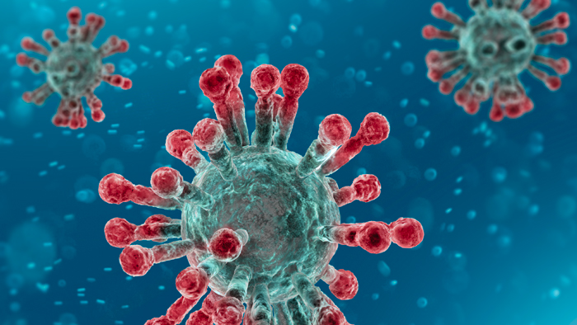
Dealing with COVID-19
2ND JUNIOR HIGH SCHOOL OF ALMYROS, GREECE

Slide 2
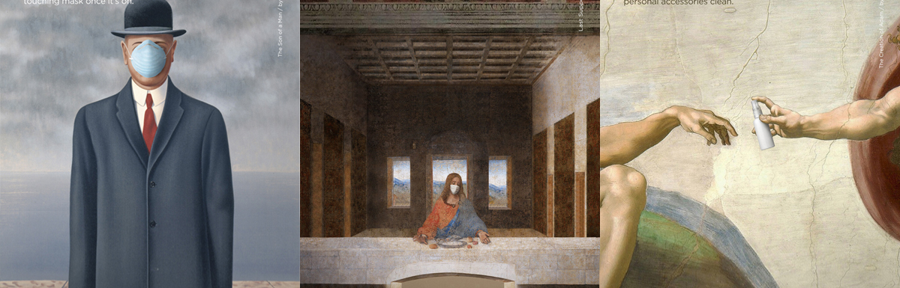
- We live an unprecedented experience.
- We were not prepared for something similar.
- It has been argued that we are living a war, without military violence.
- This is the biggest global crisis in economic and social level since World War II
GENERAL FINDINGS

Slide 3
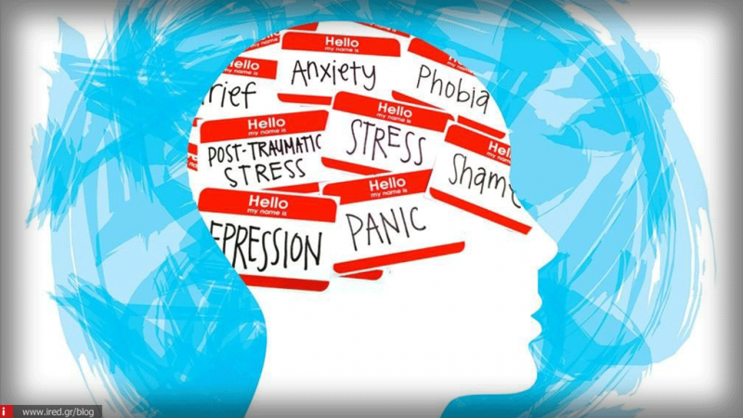
WHAT WE ARE FACING
Today we are facing many things that we do not know how to manage:
Anxiety
Insecurity
Economic, social, psychological difficulties
Fear for our lives and the lives of our own people.

Slide 4
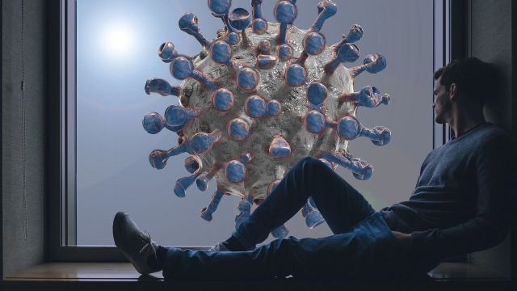
We are afraid of:
How will the Covid-19 pandemic affect us?
Will we survive?
How much will it cost for our family planning?
Will we make it?

Slide 5
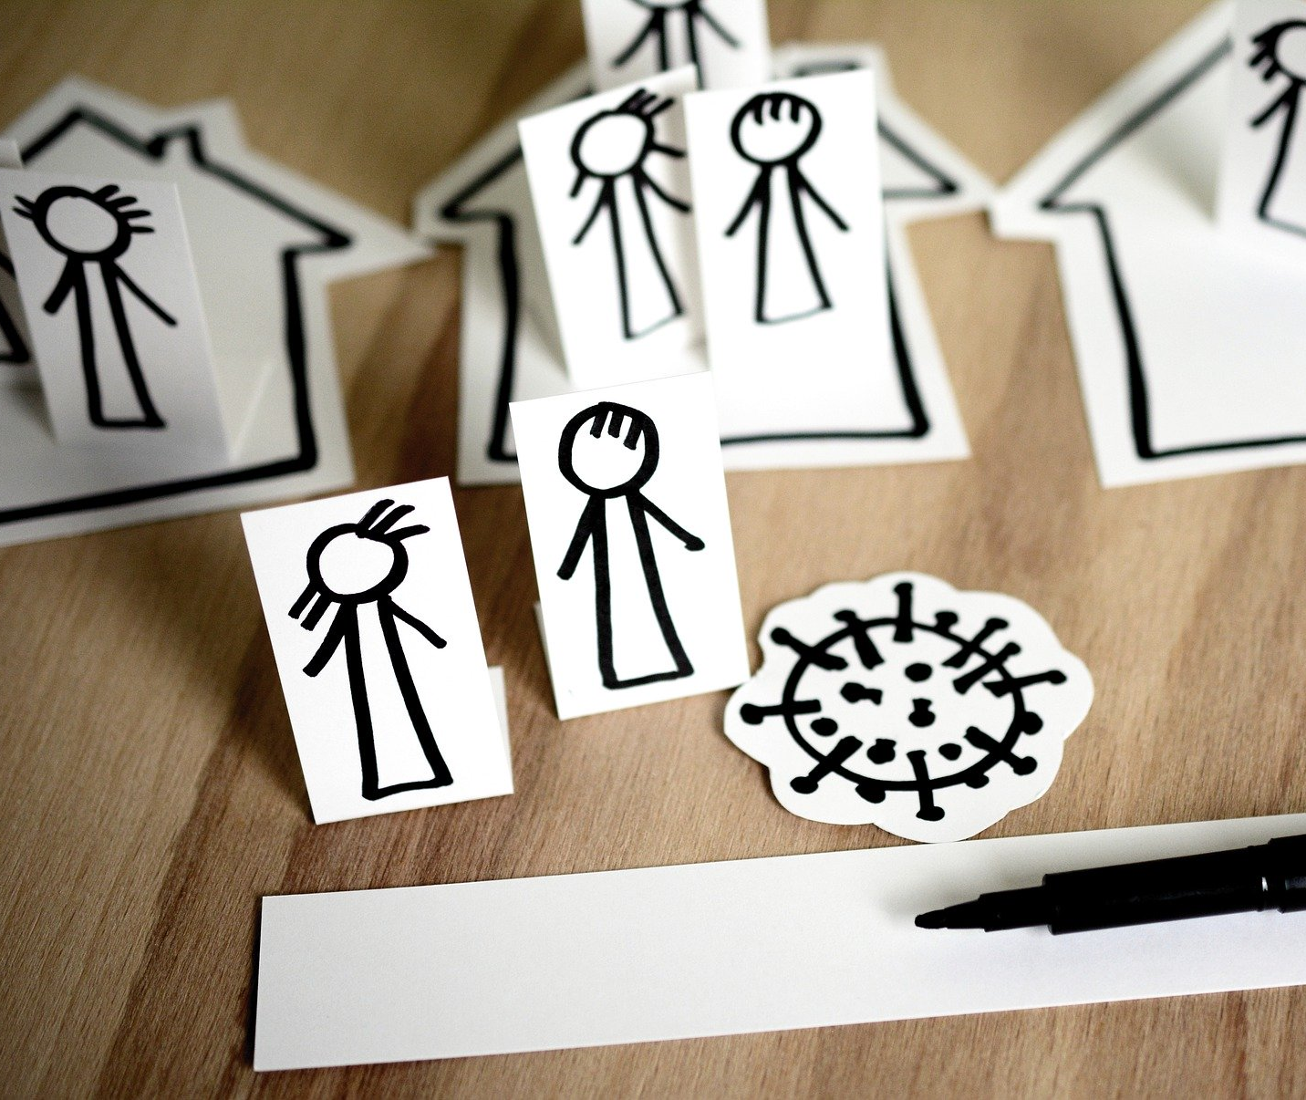

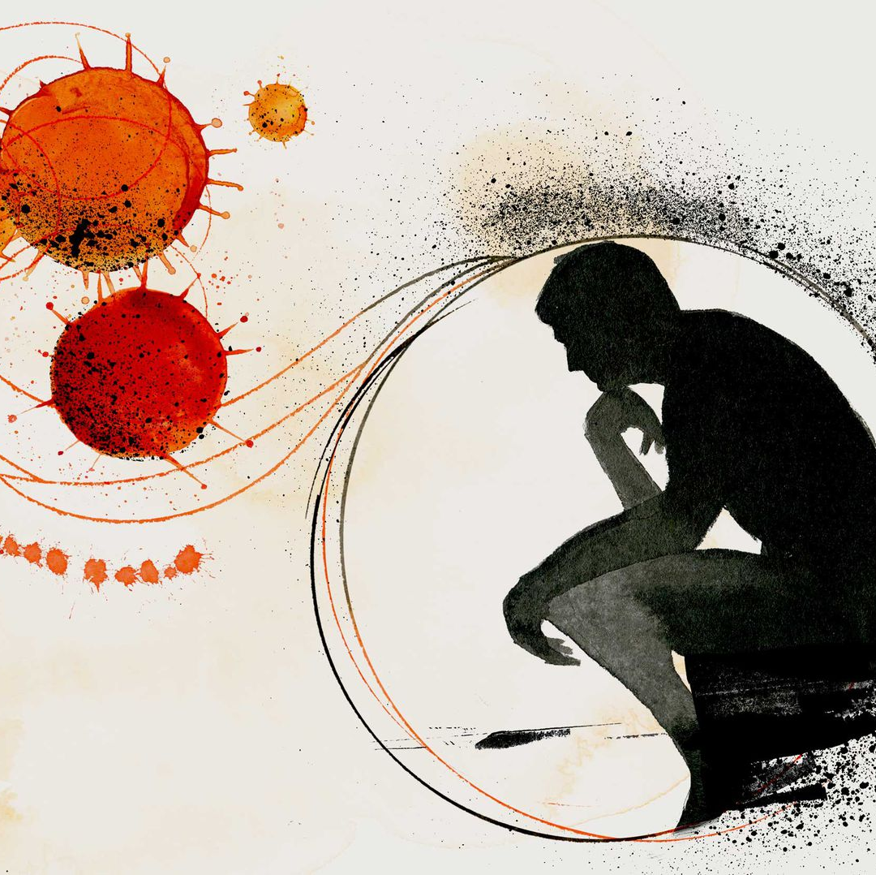

what we feel
Clearly, there are normal responses to an abnormal condition. We may have already encountered some:
Strong feelings
Fear
Refusal
Other symptoms, such as headaches, nightmares, insomnia, fatigue.

Slide 6

How we react
Those are gradually being replaced by:
Frustration,
Dissatisfaction,
Denial of expectations
And then from:
Recovery
Redefining the situation
Treatment

Slide 7
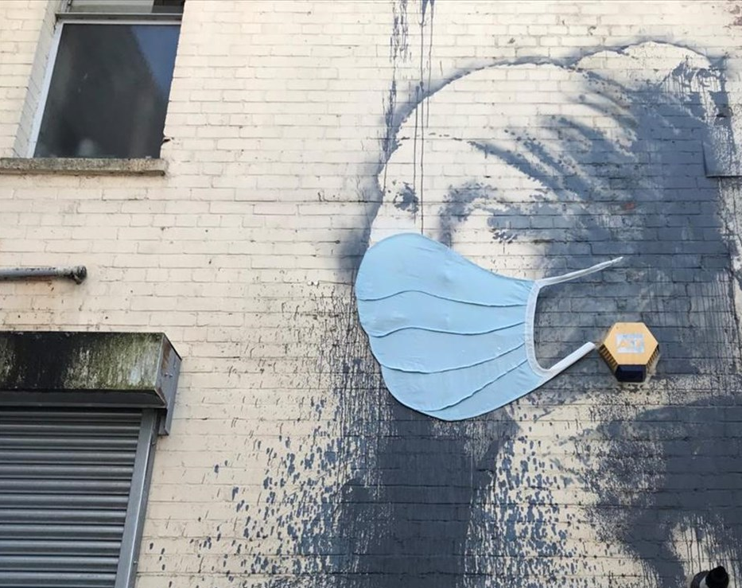
Pathological reactions
There are cases where the treatment is not normal:
Psychological difficulties
Expanded and constant stress
Desperation
Depression
Constant sense of danger

Slide 8
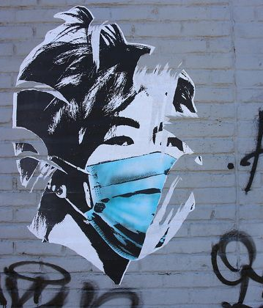
STAYING IN CONDITIONS
OF STRESS
Everyone is overwhelmed by stress:
He (she) has negative thoughts
He does not think of the future with positive colors
He focuses on problems
He is unable to concentrate on what he is doing
He changes the way he thinks, all those ideas and beliefs that allowed him (her) to feel safe in his environment, with the people around him.

Slide 9

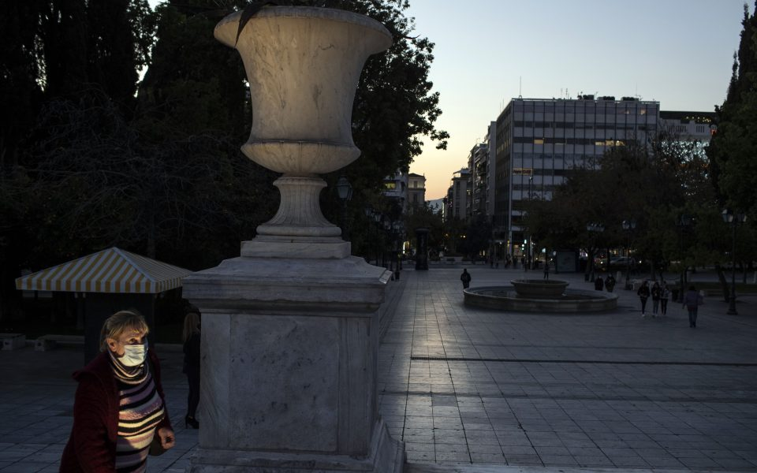
The two lockdowns
A’ Lockdown
Fear
Reverent adherence to measures
B’ Lockdown
Fatigue
Disappointment
Fear because the virus is now around us, to acquaintances, to our friends
The upcoming winter does not help at any level
Shock
We achieved a lot
Mental burden
We avoided even more

Slide 10

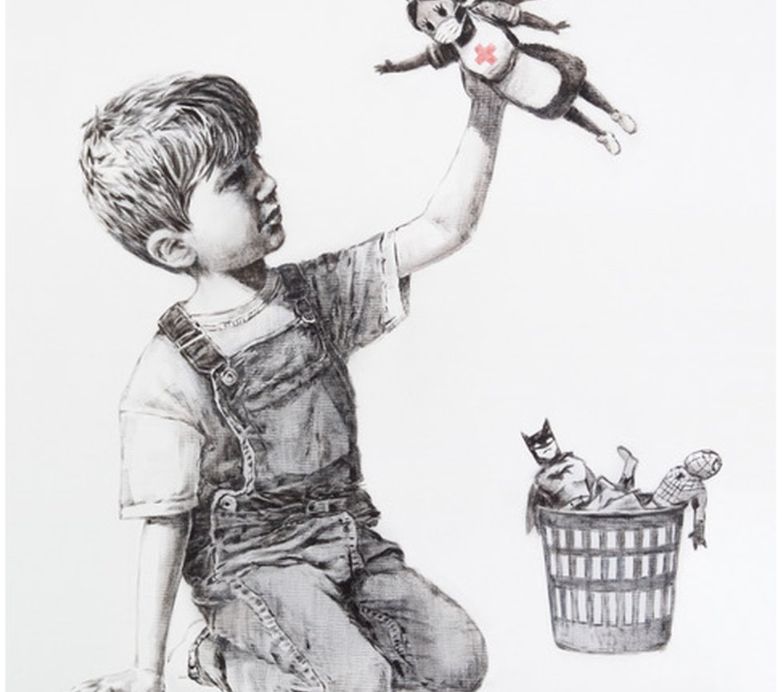
The absurd
Isolation and social distance are essential
Social mobilization and solidarity are required.

Slide 11
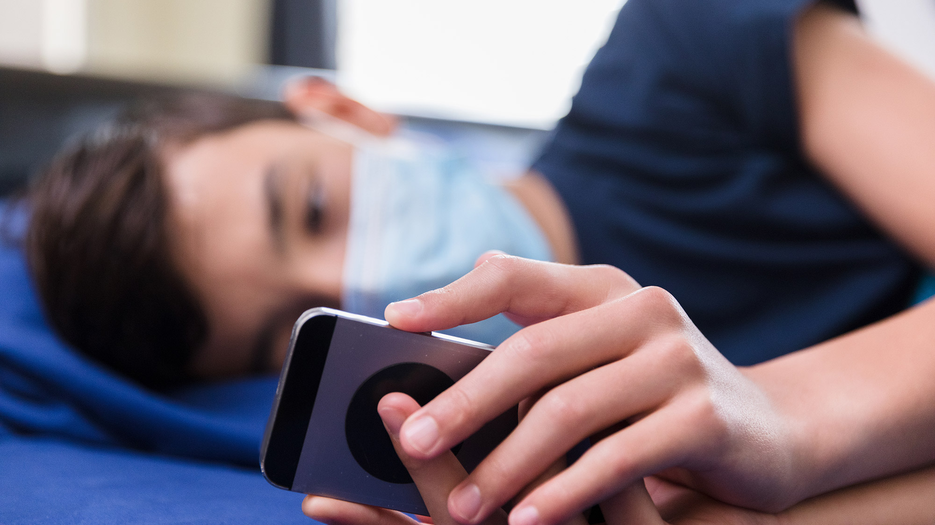
THE TEENAGERS
Teenagers have not left untouched by everything that happens around them.
Their lives has changed drastically.
In the past, quarreling with their parents was the hours they spent in front of electronic devices.
Now extending this time is the goal and sometimes the solution to many problems.

Slide 12

WE ARE TAKING CARE OF:
1. Our health
Protecting our health is always required.
Today our children need us more.
The adherence of the measures will protect us, those around us and will set an example for our children.
We stay healthy and safe!!!

Slide 13
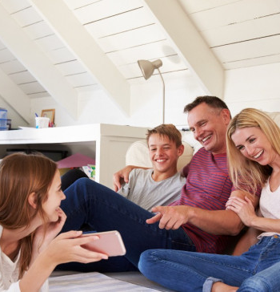
WE ARE TAKING CARE OF ….
2. The relationships between family members
The first “incarceration” showed us that all families were not ready to manage their shared time at home.
Signs and quarrels are frequent and sometimes more powerful.
Divorce claims and domestic violence cases have risen.
Can we let this happen to our family?

Slide 14
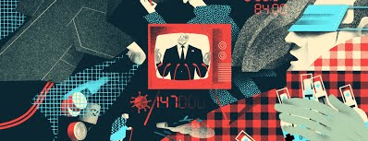

WE ARE TAKING CARE OF:
3. Overexposure to the news.
Constant exposure to the virus is not what is required.
There is over-information, sometimes wrong or excessive, sometimes false and not rarely conspiracy theories are spread.
Brief and sober information and discussion with the children about it.

Slide 15
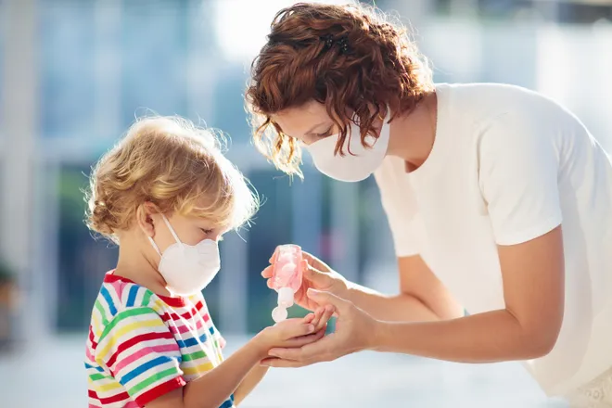
AS PARENTS…
Checking out our health
We take care of our health.
It goes without saying, it has been heard so much that it has become an experience.
Is it really happening?

Slide 16
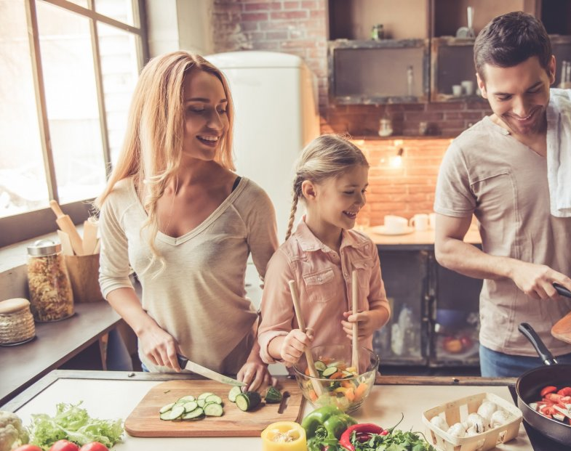
AS PARENTS
2. Forming a new routine
Routines are important in the family, especially at this time.
Constant wake-up time, lunch with the whole family, evening meetings and discussions, watching a movie and chatting.
Small and everyday things and habits that we do with our partner and our children.

Slide 17
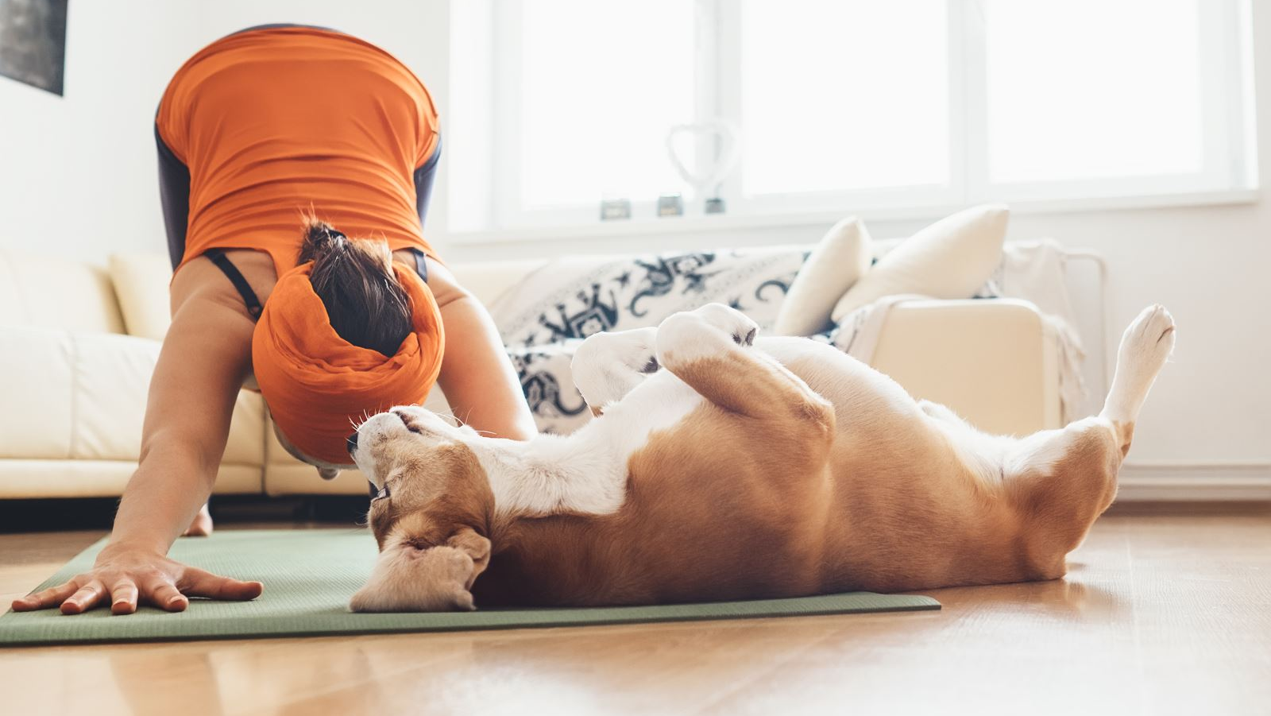
As parents
3. Maintaining fitness as much as possible
Balanced nutrition
Avoid excessive sugar
Moderate exercise, even at home
Moderate sun exposure
Good sleep
Are important for maintaining fitness even in conditions of confinement or subsequent social distancing.

Slide 18
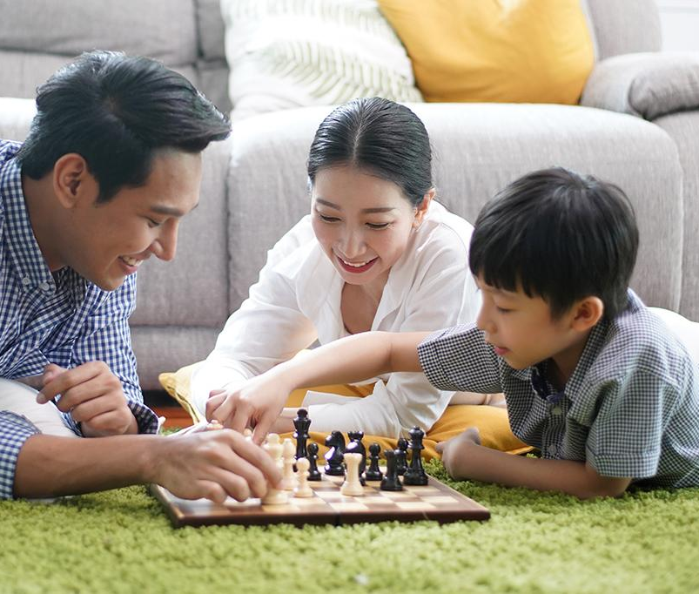
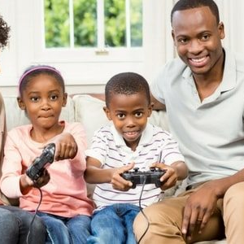
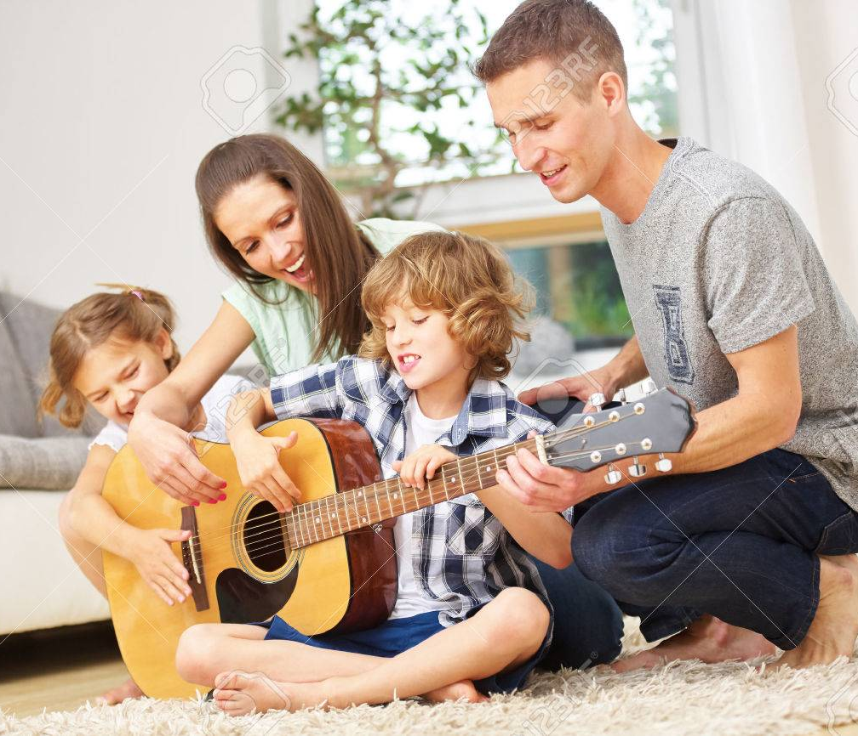
AS PARENTS….
4. Various stimulations
Stimulations and activities do not stop due to inclusion.
There are many activities that we can do using our devices:
Theatrical and musical performances
Guided tours of major museums and online tours of countries and monuments
Game for children of all ages.
Older children also want to play.

Slide 19

As parents…
5. Books
Timeless companion in all moments of our lives.
Especially in these conditions they can help us effectively.
They give examples to the child, enhancing his imagination and creativity.

Slide 20
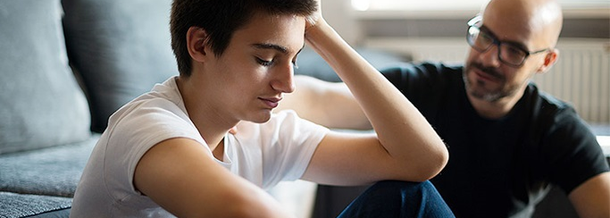
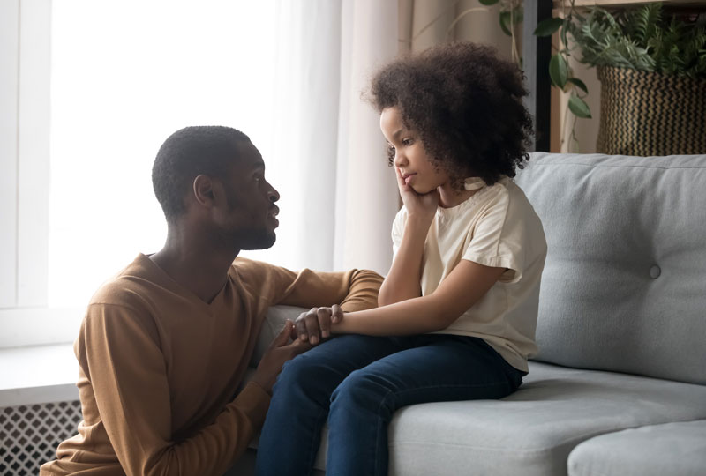
As parents…
6. Expressing the emotions.
Children need to express their feelings, such as anxiety, fear, insecurity.
The help we give them to express themselves will relieve them and calm them down.
The outlook for the future is important, as Covid-19, like other pandemics, has a beginning, a middle and eventually an end.

Slide 21
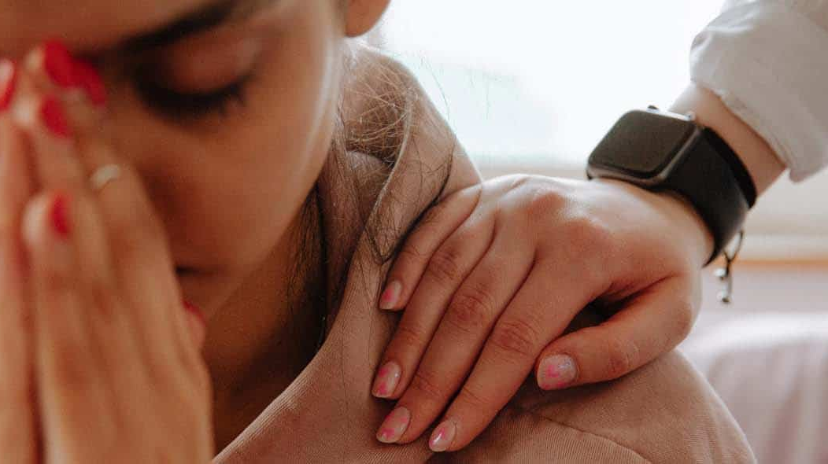
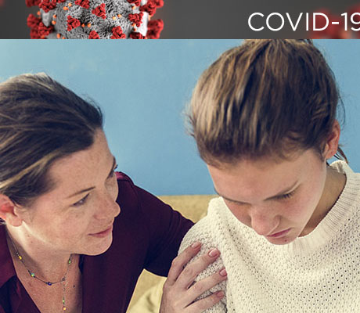
As parents….
7. Taking relief aid
Parents always, even more so in the present circumstances, act as those who can help children.
Teenagers feel a little like "free besieged".
Parents need to be available and work gently and flexibly to absorb their children's tension.

Slide 22
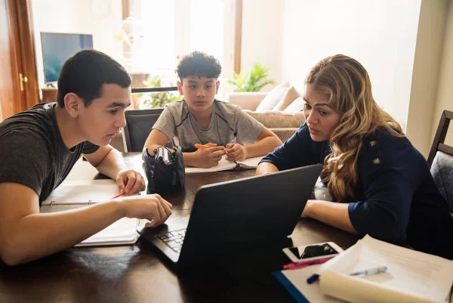
As parents…
8. Seeking for help
And we adapt new habits, we work with different data.
Sometimes we do it better, sometimes worse, but we still try…
It is not bad to ask children to help us in our daily difficulties and of course in everything related to technology.

Slide 23
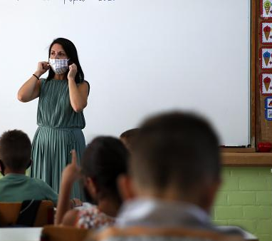
As parents….
9. Cooperating with teachers
Children sometimes express to teachers what they can not, do not want, hesitate, are afraid to share with their parents.
It is important to work with the child's teachers in order to have a coordinated help.

Slide 24

As parents….
10. Seeking for Help from specialists
In case of inability to handle our psychology or our childrens’ one,
we can ask for help from specialized people, structures, support lines:
Psychologists
Mental Health Specialists
Psychosocial Support Lines

Slide 25
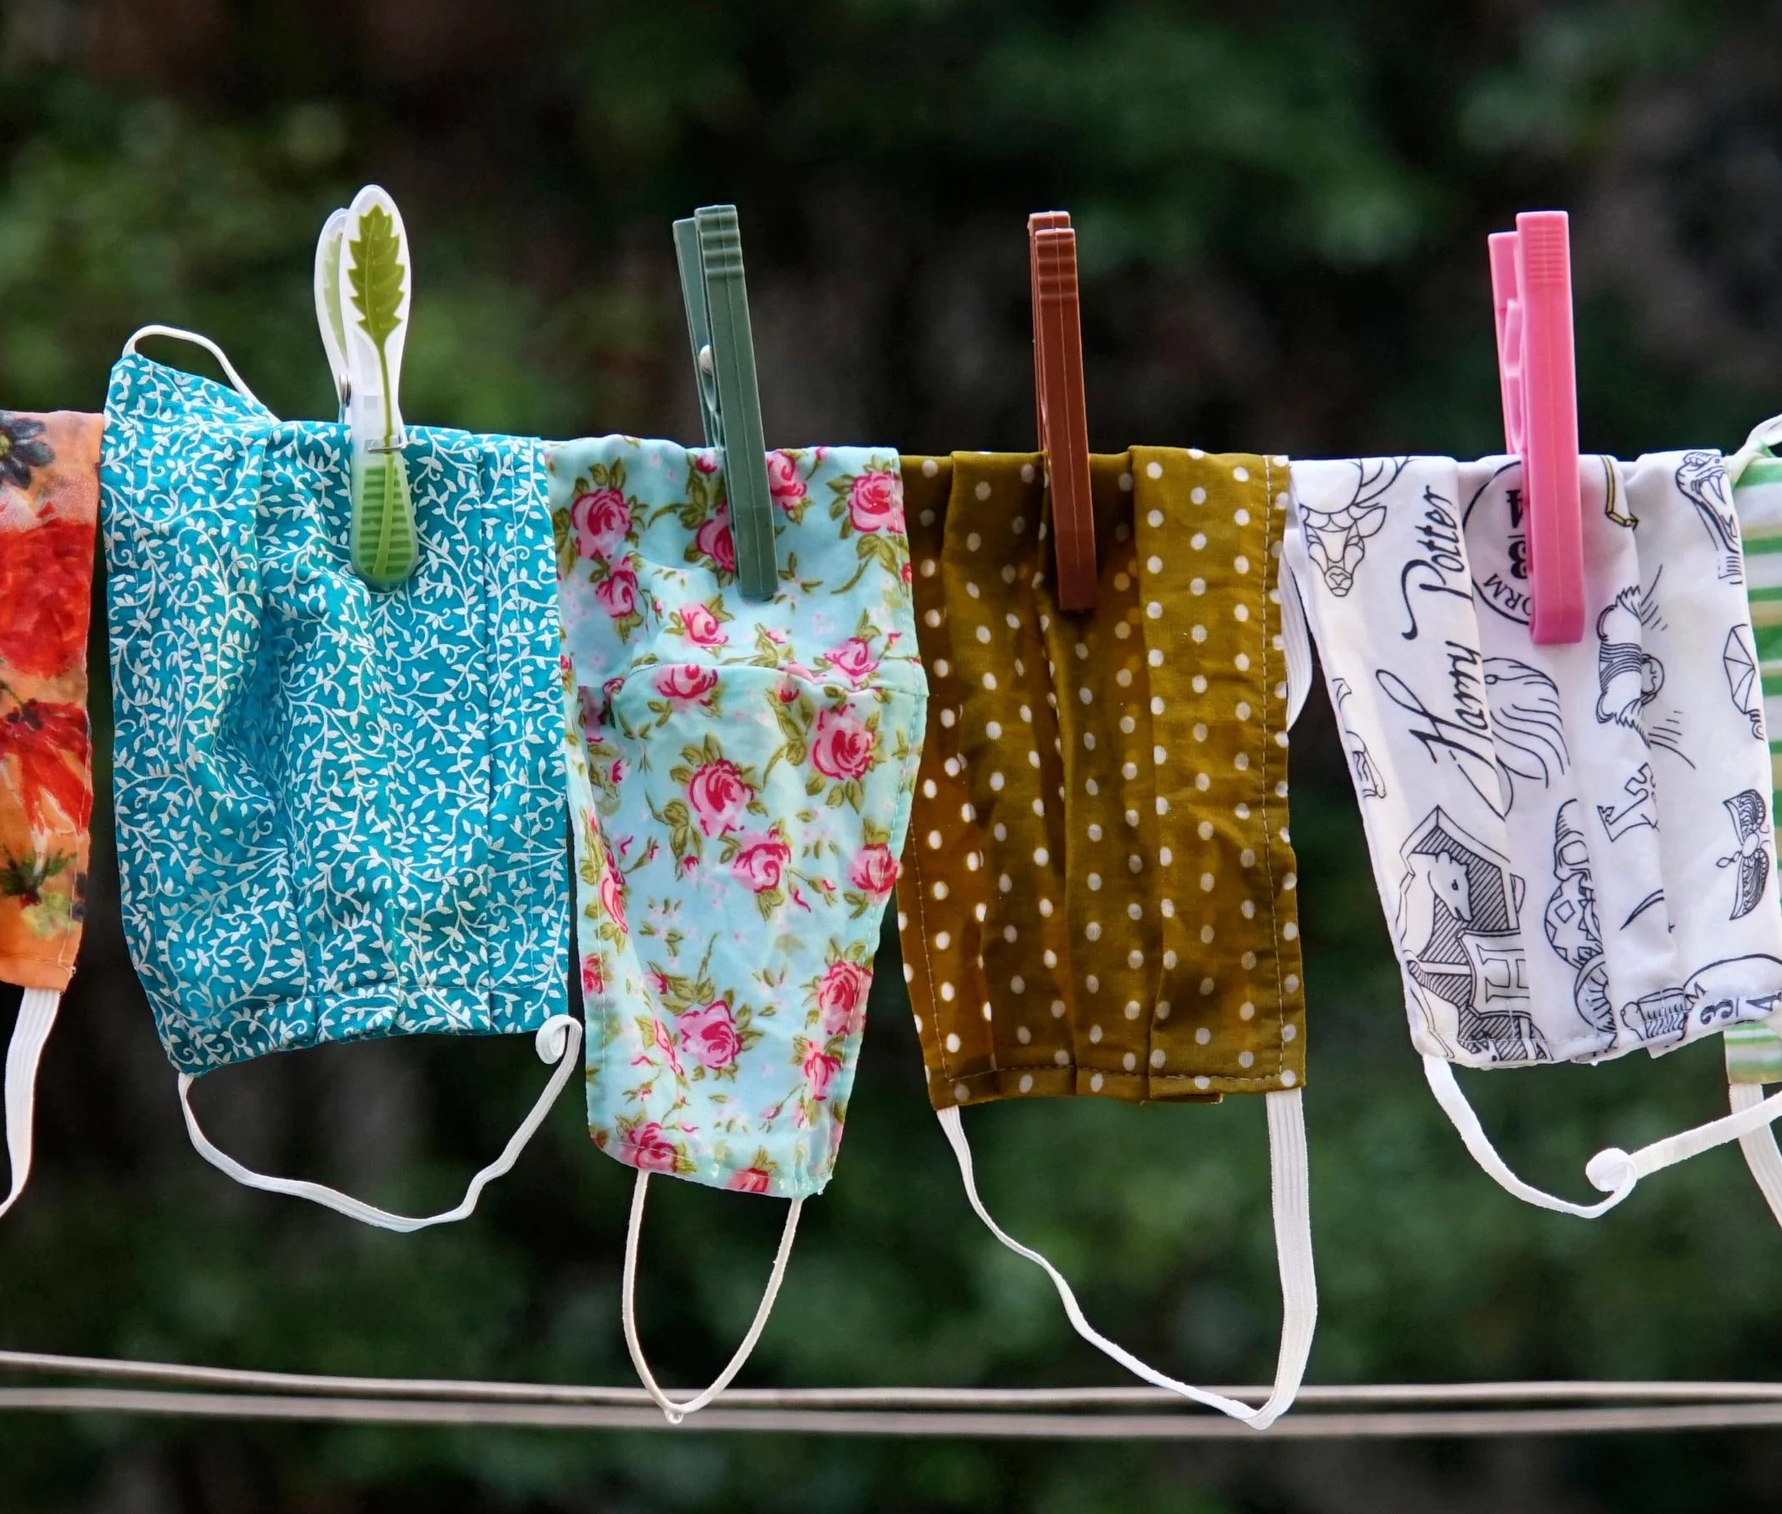
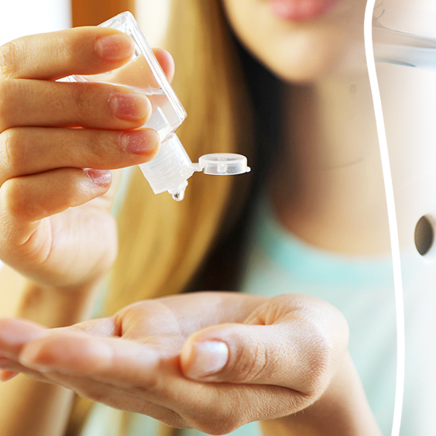

Teenagers….
1. Attention to health
Highly discussed but always up to date.
As commonplace as it is, health is precious.
Hygiene measures, masks, online meetings, exposure avoidance are always required.

Slide 26
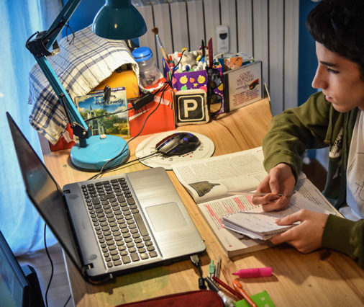
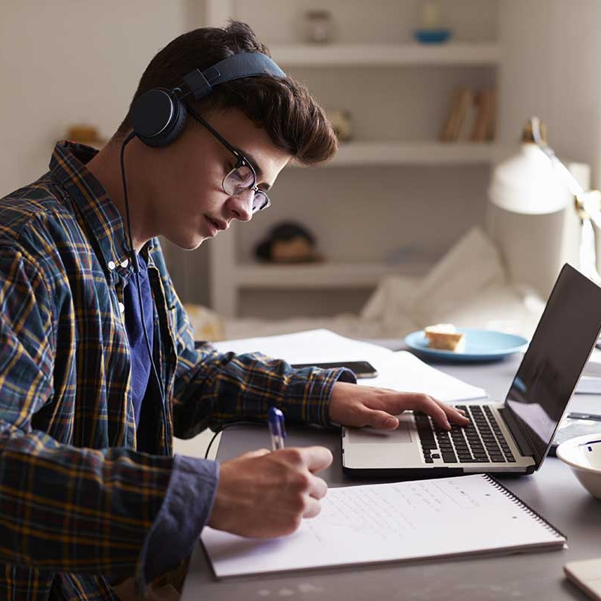
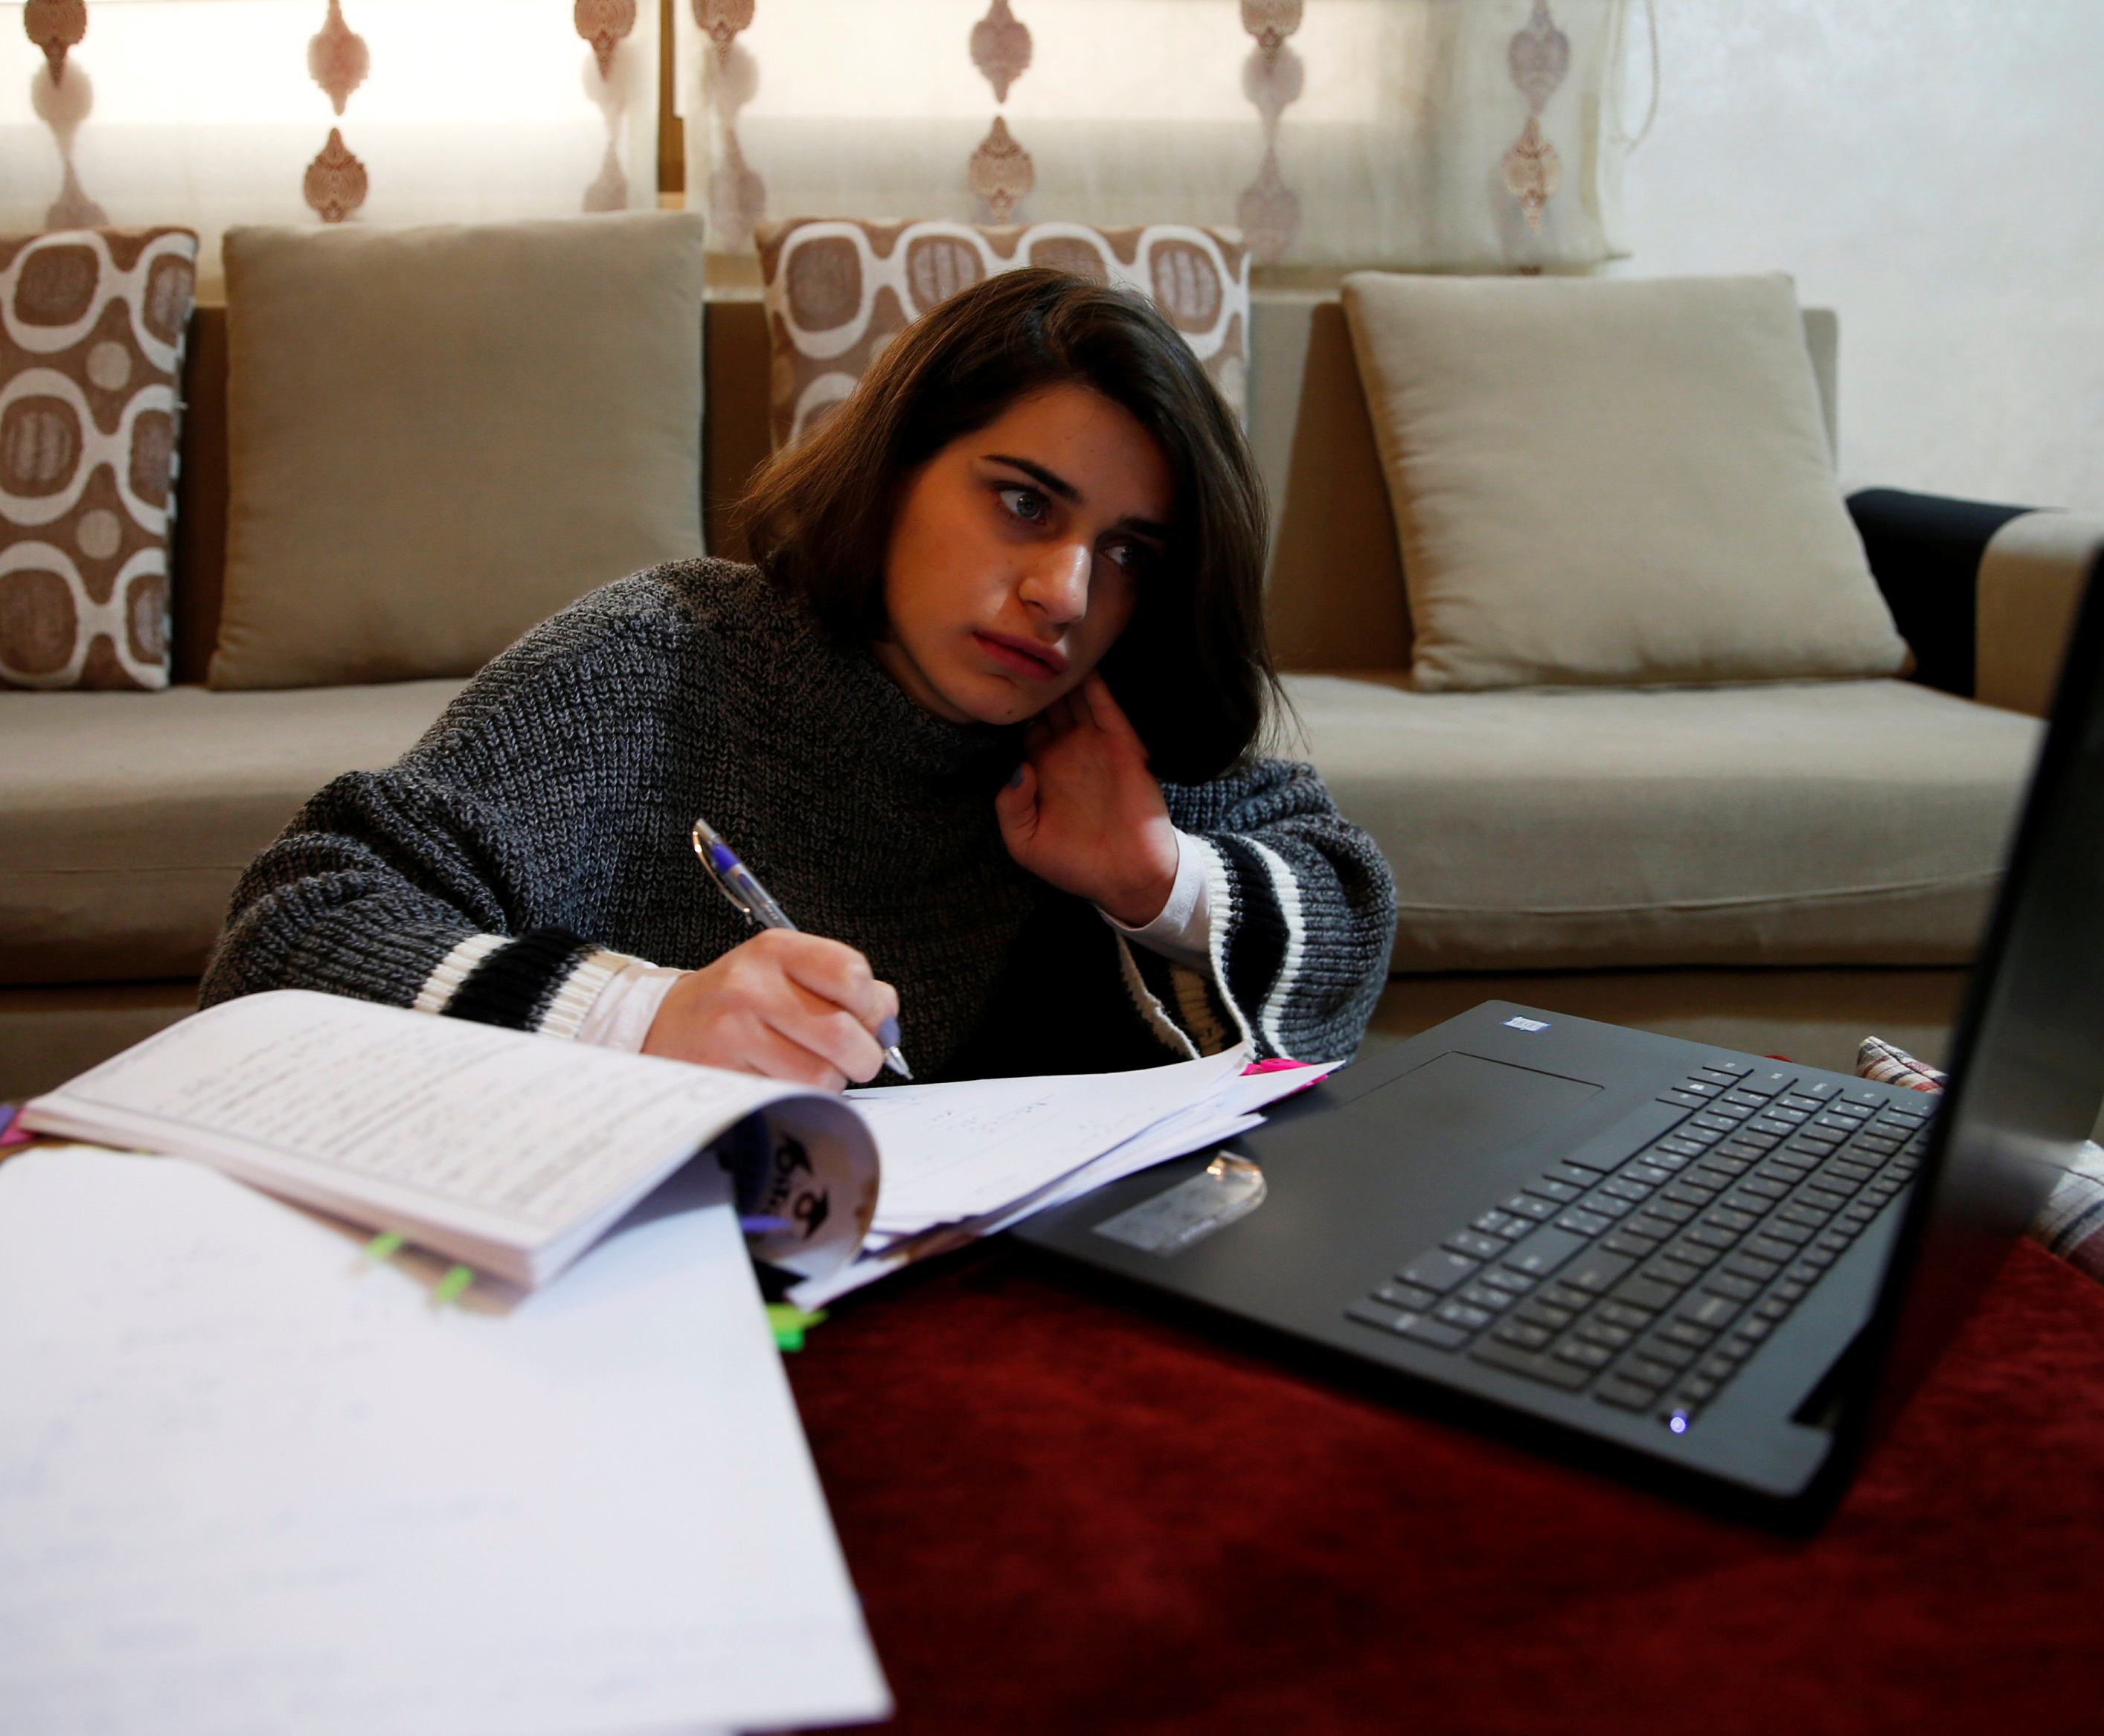
Teenagers….
2. Distance education
E-learning is not a panacea, but it is the only solution we have, so that we can deal with this abnormal situation..
Ιt is difficult, tedious, annoying in many cases, but it can help.

Slide 27
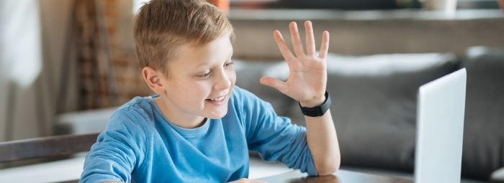
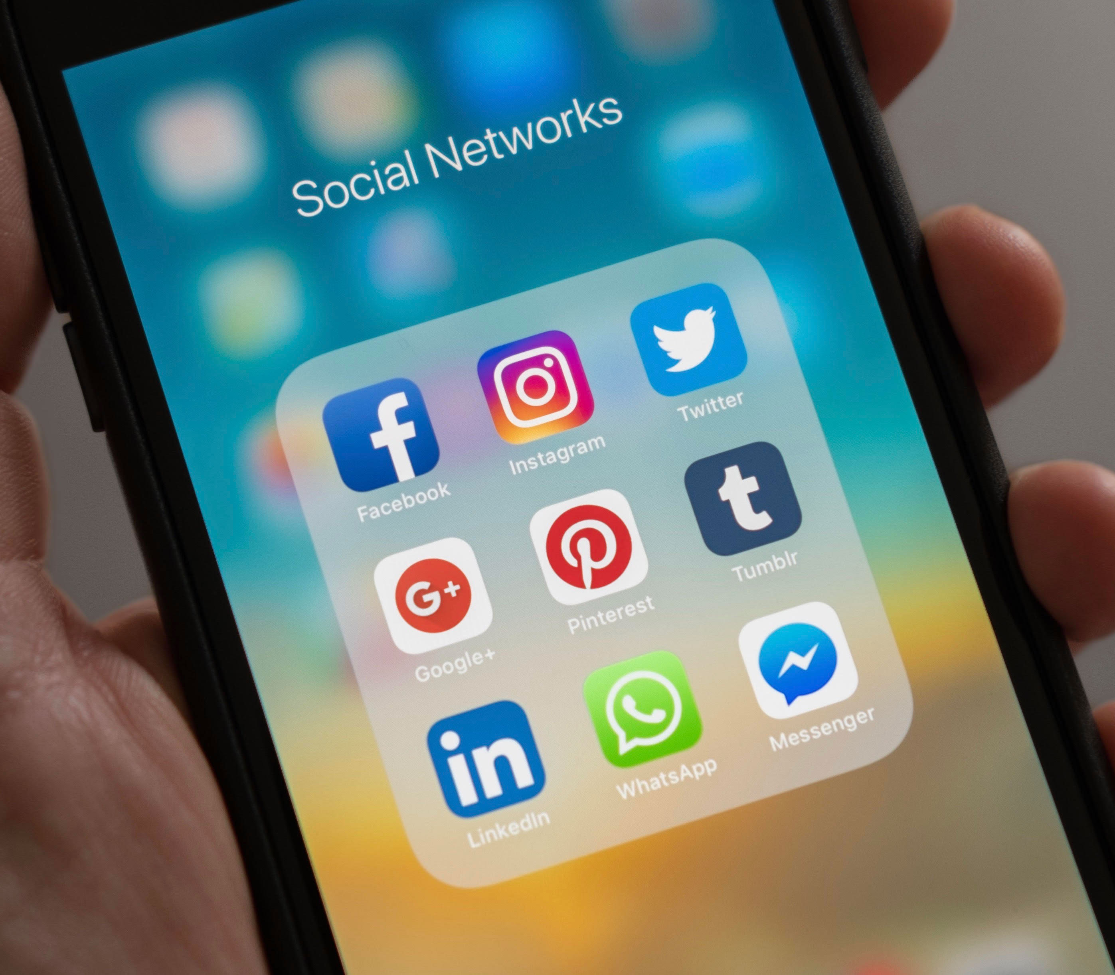
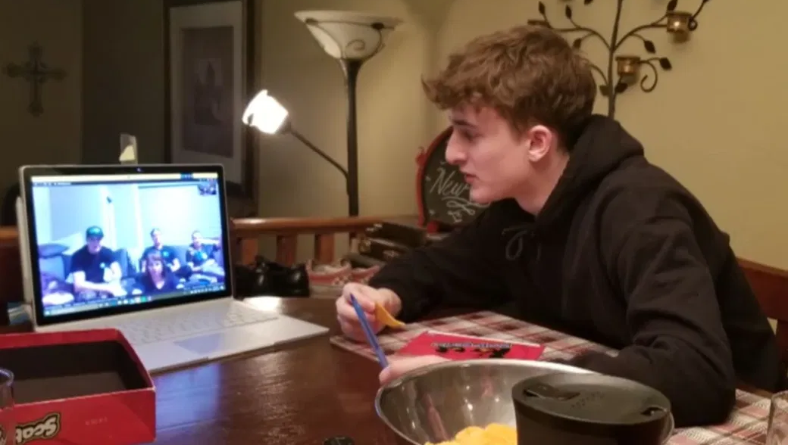
Teenagers….
3. Alternative ways of communication.
They stay at home. They are alone. They are not with their friends.
But they have a mobile, internet connection, social media.
They can talk to their friends, even if they can't see them up closely.

Slide 28
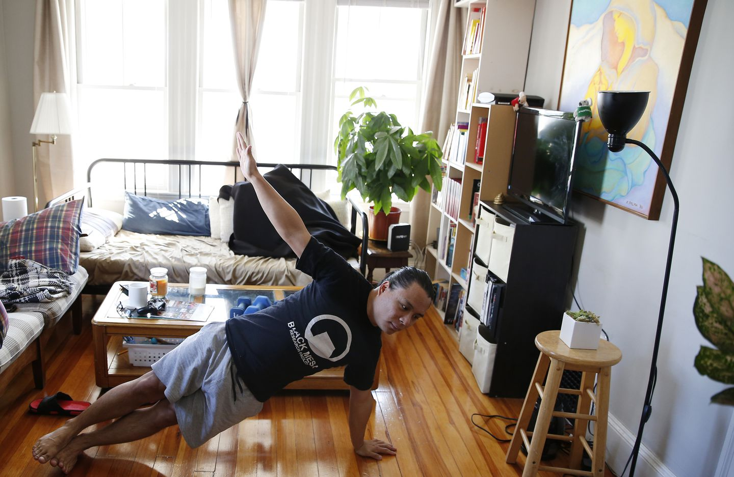
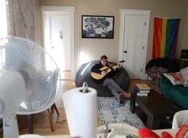
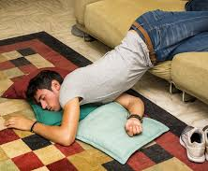
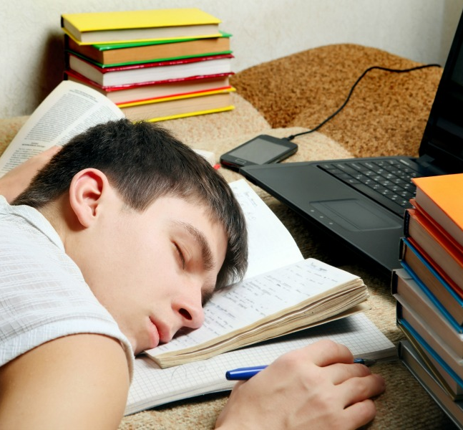
Teenagers….
4. Enjoying the rest
It is a unique and unrepeatable opportunity to rest, to sleep a little more.
It is an equally unique opportunity to do things that relax them, a little exercise at home, to start a new hobby.

Slide 29

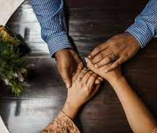
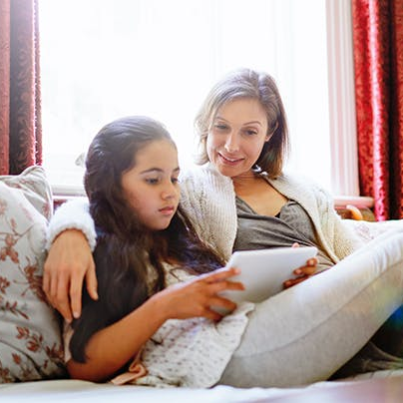
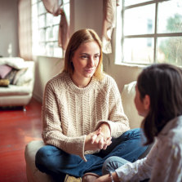

Teenagers….
5. Discussion is important
For everything that scares them, for everything that pressures them, for everything that they would like a second opinion.
In their environment, family, friendly, educational, there are always people they can turn to.

Slide 30

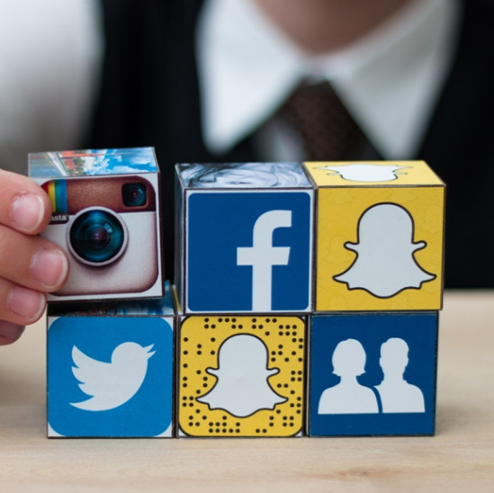

Teenagers….
6. Engaging with the internet
At this moment, engaging with the internet is helpful.
It can offer opportunities, help them calm and feel relaxed.
With Social Media they can get in touch with their friends, comment, laugh, unwind.

Slide 31

The crisis offers prospects
Every crisis can be an opportunity for introspection, analysis, rearrangement, configuration, synthesis, development:
It enables the redefinition of the requested and priorities.
However, it also offers the possibility of re-examining what we previously considered data, repositioning towards them.
Finally, it offers the opportunity to change ourselves, the world, the future.

Slide 32

The crisis offers prospects
This crisis gives us the opportunity to see our relationship with our children again.
It is the right opportunity to turn to them, to restore our relationship with them (and vice versa).
By helping them overcome their fears, we help ourselves to overcome our owns.
Giving to children, we always get multiples.

Slide 33
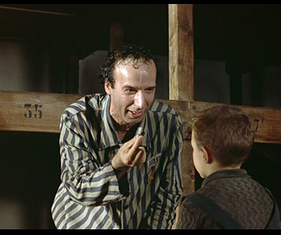

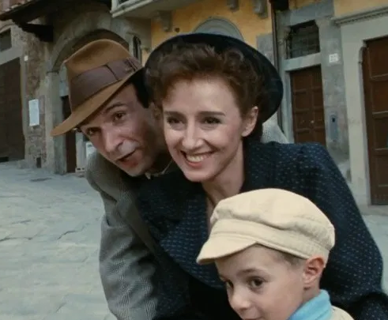
WHAT ABOUT watching the movie “La Vita è Bella” again?
In this film Roberto Benigni as Guido Orefice, a bookshop owner, employs his fertile imagination to shield his son from the horrors of internment in a Nazi concentration camp.
We live in conditions of war, but fortunately the conditions are better now.
We can do it together !!!!

Slide 34
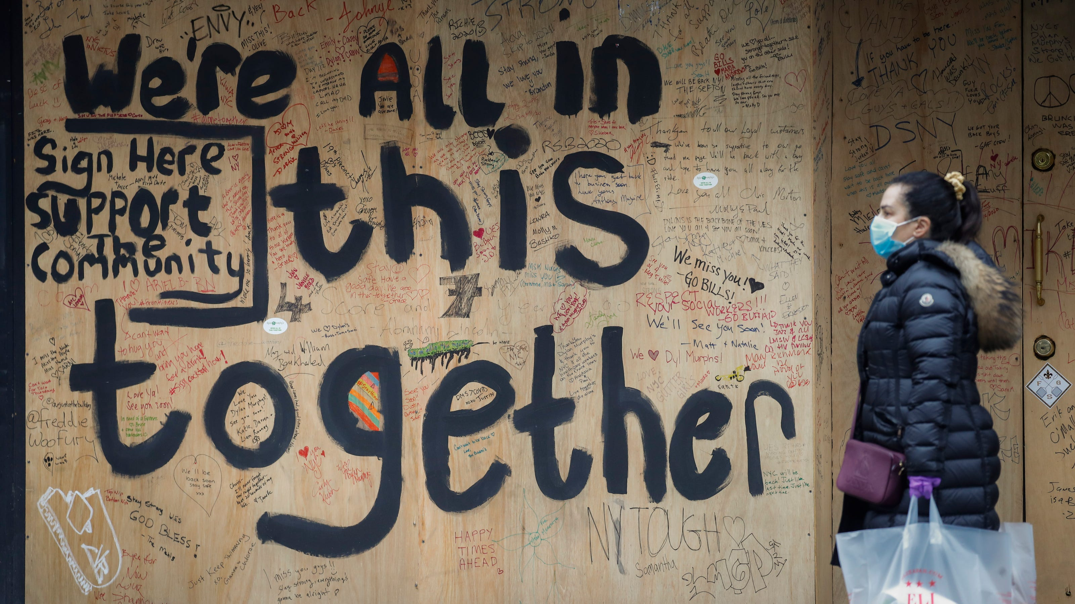
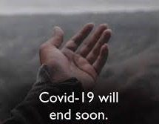
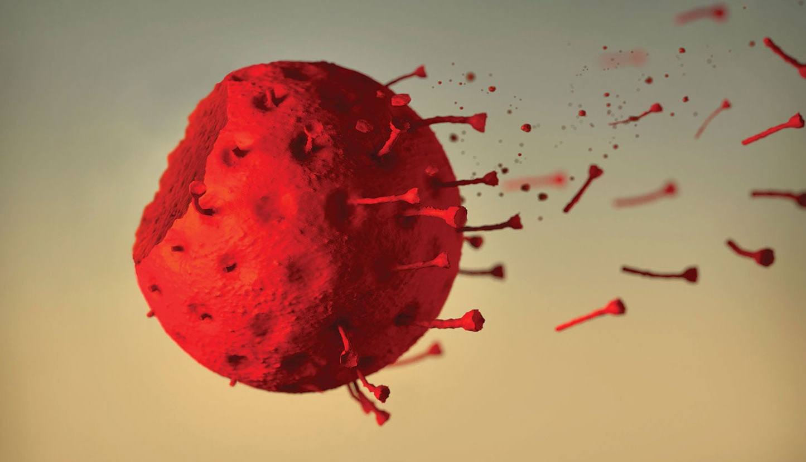
Thank you all.
The
Erasmus “THatS”
Team.

